Slide 1
Image-Based Situation Awareness Audit 28.2.2018
Sakari Lampola

Slide 2
Previous Audit 11.1.2018

Slide 3
Open questions:
Role of classical object tracking alrorithms?
What to do with multiple bounding boxes around one object?
Appropriate minimum confidence level?
What to do with false detections inside other objects?
What to do with false detections from the background?
How to set Kalman filter parameters for image object filtering?
Hungarian algorithms special case for hidden objects
To do:
Close open questions
Image object status
Image object velocity estimation
Probabilistic approach for matching detected and image objects
2d -> 3d transformation
World object state estimation
Other:
Semantic segmentation
Organisations to follow: ICCV, ICRA, NIPS, IROS, arXiv
Camera motion (yaw, pitch)
Grid or continuos presentation?
Class specific attributes
Object history
Previous Audit

Slide 4
Project Plan

Slide 5

Project Plan
Methodology / Preparation of research infra
Software platforms are constructed and tested
Off-the-shelf models are acquired and tested
Necessary skills on platforms are learned
Methodology / Method survey
Current state-of-art methods are studied
Methods are constructed and tested on the software platforms
Method follow-up
Screening of conference papers related to the subject
Possibly integrating new methods to the project

Slide 6
Work Done

Slide 7


Method Follow-Up

Slide 8
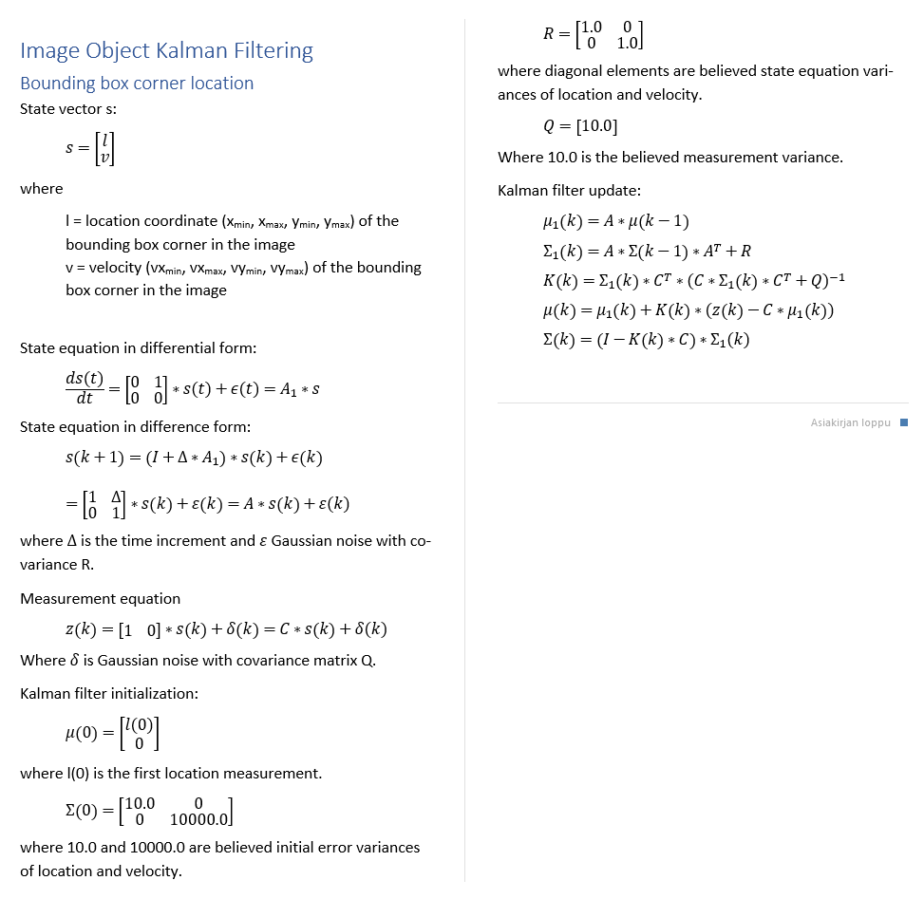
Image object velocity is necessary for:
predicting image object locations when matching new measurements
identifying image objects
predicting image object locations for hidden objects
Image object
id
status
x_min
x_max
y_min
y_max
vx_min
vx_max
vy_min
vy_max
class
confidence
appearance
Image Object Velocity Estimation
Estimation algorithm
Numerical values are estimated using grid search and 10 step ahead
mean prediction error. Values rounded. Later adjusted by experiments.

Slide 9
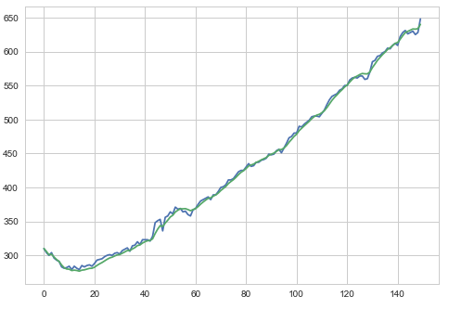
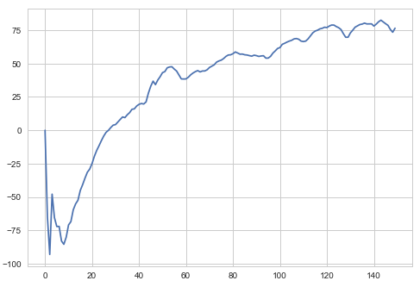
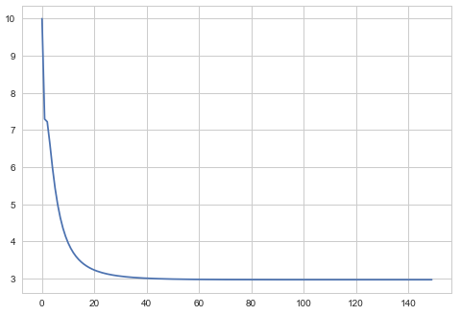
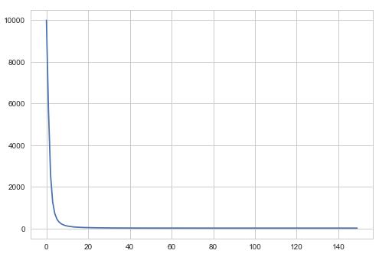
Moving object (car)
Image Object Velocity Estimation
Measured and filtered location (upper left corner)
Estimated velocity
Location variance
Velocity variance

Slide 10
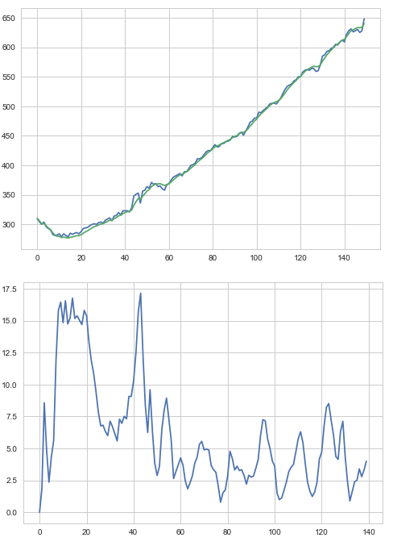
Moving object (car)
Image Object Velocity Estimation
10 step ahead mean prediction error

Slide 11
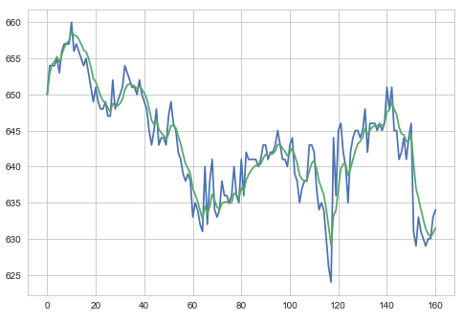
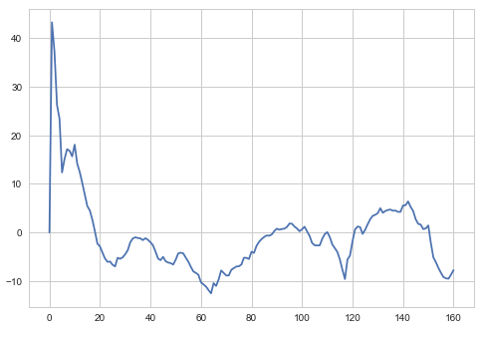
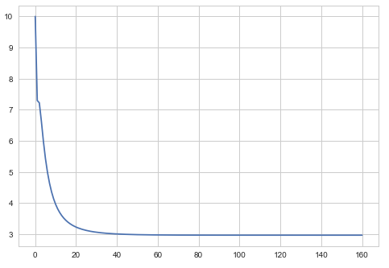
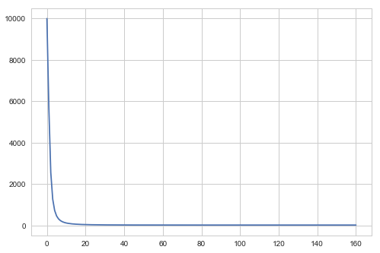
Static object (calf)
Image Object Velocity Estimation
Measured and filtered location (upper left corner)
Estimated velocity
Location variance
Velocity variance

Slide 12
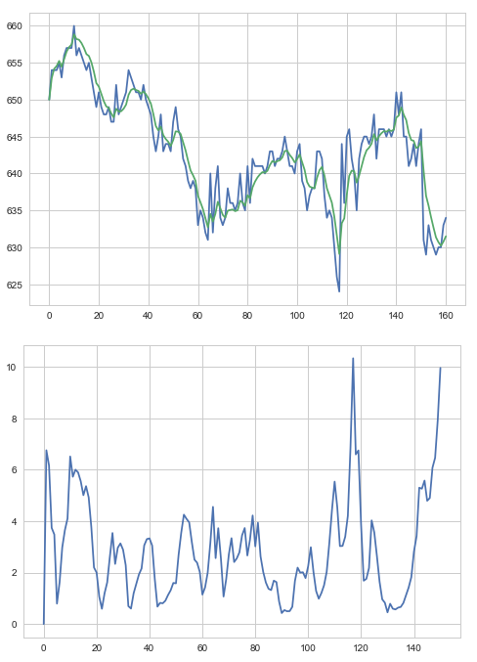
Static object (calf)
Image Object Velocity Estimation
10 step ahead mean prediction error

Slide 13
Software Architecture
Speech Synthesis
Video file
Camera
OpenCV
AnalyzeVideo
ObjectDetection
Speakers
ImageClasses
MobileNetSSD (caffe)
pyttsx3
SpeechSynthesis

Slide 14
Entities
Speech Synthesis
Image World
Image Object
Event
Event
time
text
priority
Event is generated when
new image object is created
image object status is changed
Event will pause the video for the duration of speech (not in the final version)
Events are collected (history)

Slide 15
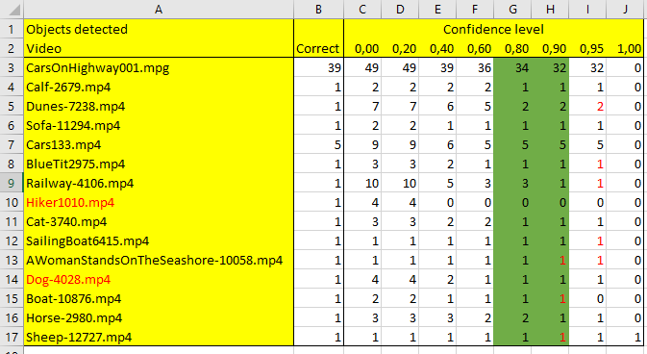
SSD Mobilenet implementation:
# extract the confidence (i.e., probability) associated with the prediction
Confidence Level
Good value for creating a new image object is between 0.8 and 0.9.
The ’good’ value also depends on other hyperparameters.

Slide 16
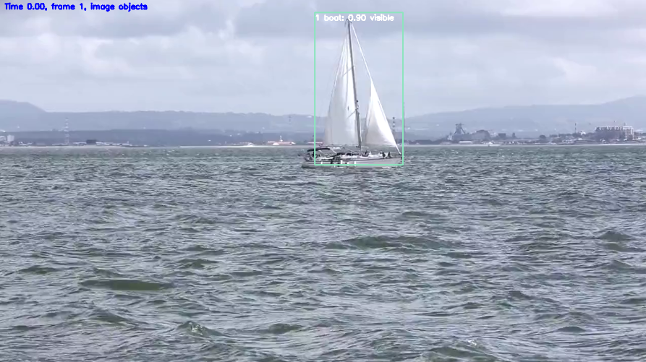
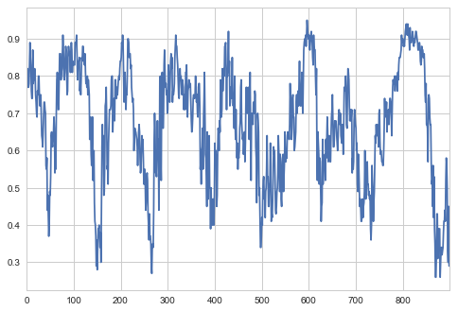
Confidence Level
Confidence level has dynamics
create
Update (not class)
ignore
Different levels for creating and updating image object. Hyperparameters:
CONFIDENCE_LEVEL_CREATE (0.8)
CONFIDENCE_LEVEL_UPDATE (0.2)

Slide 17
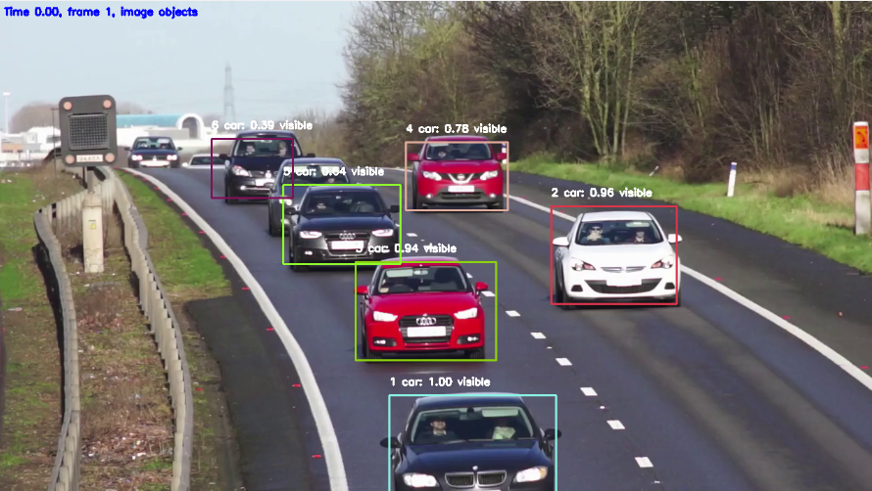
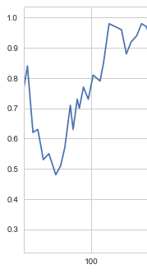
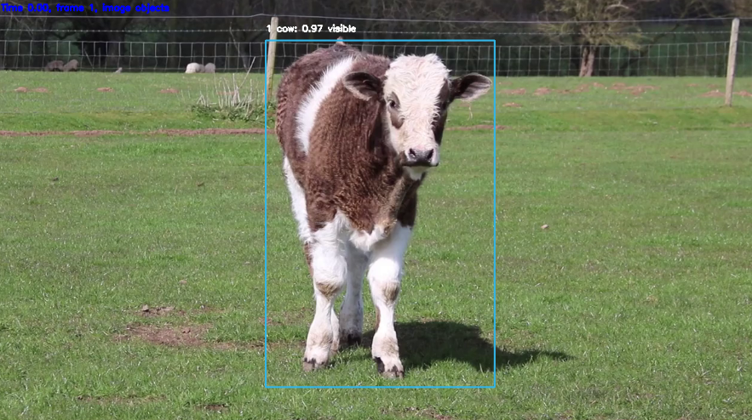
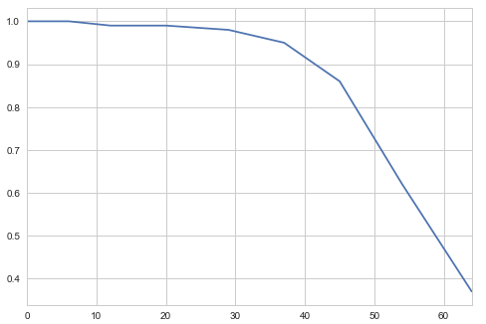
Confidence Level

Slide 18
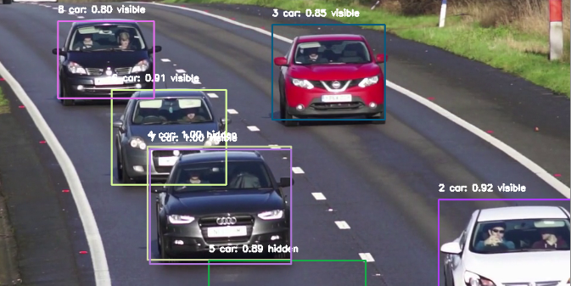
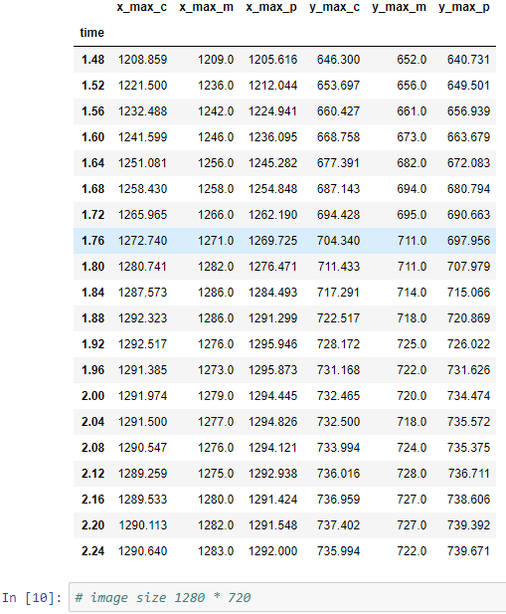
Border Behaviour
Box size and form distorded
Hyperparameter BORDER_WIDTH (30)

Slide 19
Border Behaviour
1
2
3
4
5
6
Type 3 and 5: world object not updated
Type 6: removed, world object acceleration fixed
If an object touches 3 borders, it is removed
Done for:
left
right
top
bottom

Slide 20
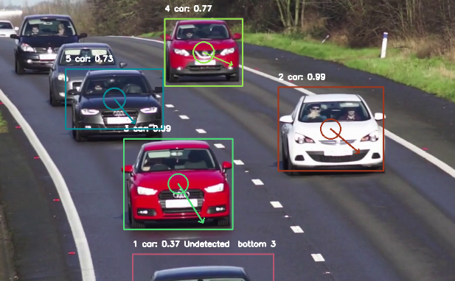
Visual Presentation
Ellipse axes proportional to the standard deviation of the location (2*std, corresponding to 95% probability)
Arrow direction and length proportional to velocity (measured in pixels/second)

Slide 21
Object Retention
Image objects are removed if not detected in RETENTION_COUNT_MAX (30) successive frames.

Slide 22
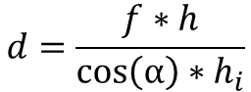
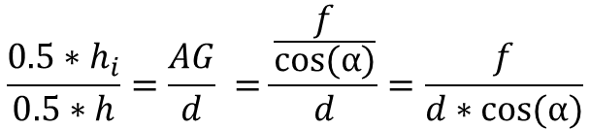
D
Distance Estimation
F
h
E
C
G
h_{i}
AF=d (distance)
A
B
α
f
Similar triangles AGE and AFD:
$$\frac{{0.5∗h}_{i}}{0.5∗h}=\frac{AG}{d} =\frac{\frac{f}{cos⁡(α)}}{d}=\frac{f}{d∗cos⁡(α)}$$
$$d=\frac{f∗h}{{\cos\left(α\right)∗h}_{i}}$$
Similar equations for horizontal direction
(β=azimuth)

Slide 23
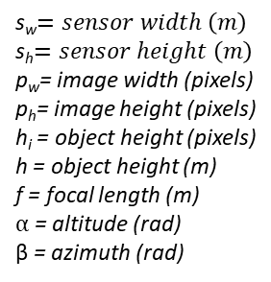
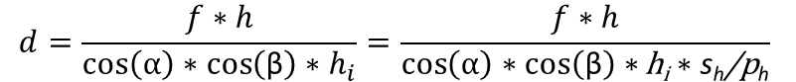
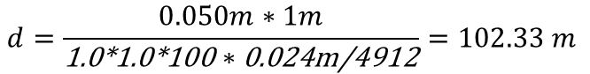
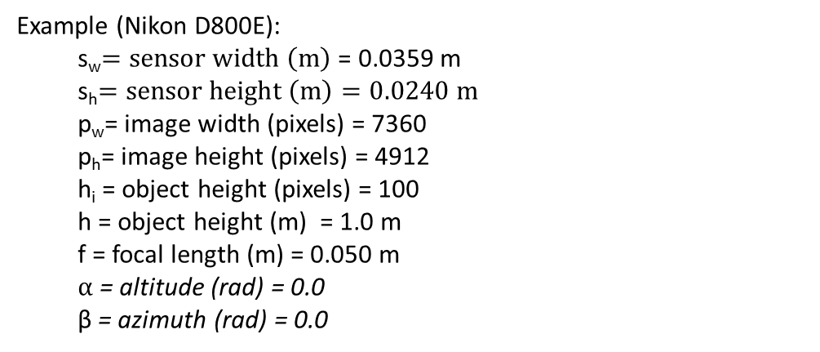
$$d=\frac{f∗h}{{\cos\left(α\right)∗\cos\left(\text{β}\right)∗h}_{i}}=\frac{f∗h}{\cos\left(α\right)∗\cos\left(\text{β}\right)∗\text{h}\text{i}∗\text{s}\text{h}\text{/}\text{p}\text{h}}$$
s_{w}$=sensor width \left(m\right)$
s_{h}$=sensor height \left(m\right)$
p_{w}= image width (pixels)
p_{h}= image height (pixels)
h_{i} = object height (pixels)
h = object height (m)
f = focal length (m)
$α$ = altitude (rad)
β = azimuth (rad)
Distance Estimation
Example (Nikon D800E):
s_{w}$=sensor width \left(m\right)$ = 0.0359 m
s_{h}$=sensor height \left(m\right)=0.0240 m$
p_{w}= image width (pixels) = 7360
p_{h}= image height (pixels) = 4912
h_{i} = object height (pixels) = 100
h = object height (m) = 1.0 m
f = focal length (m) = 0.050 m
$α$ = altitude (rad) = 0.0
β = azimuth (rad) = 0.0
$$d=\frac{0.050m∗1m}{\text{1.0∗1.0∗100}∗\text{0.024}\text{m}\text{/4912}}=102.33 m$$

Slide 24
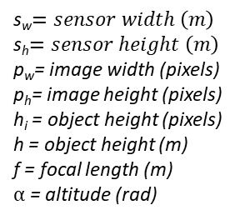
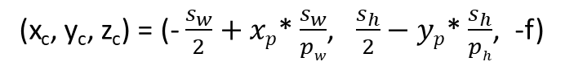
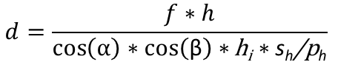
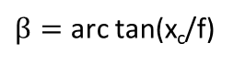
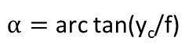
2d -> 3d Transformation
y
x
z
From pixel coordinates (sensor plane) to 3d camera coordinates:
s_{w}$=sensor width \left(m\right)$
s_{h}$=sensor height \left(m\right)$
p_{w}= image width (pixels)
p_{h}= image height (pixels)
h_{i} = object height (pixels)
h = object height (m)
f = focal length (m)
$α$ = altitude (rad)
(x_{c}, y_{c}, z_{c}) = (- $\frac{s_{w}}{2}+xp$* $\frac{s_{w}}{pw}$, $\frac{s_{h}}{2}−yp$* $\frac{s_{h}}{ph}$, -f)
Object center will be on the line:
(x_{o}, y_{o}, z_{o}) = t* (x_{c}, y_{c}, z_{c})
The length of the line is:
$$d=\frac{f∗h}{\cos\left(α\right)∗\cos\left(\text{β}\right)∗\text{h}\text{i}∗\text{s}\text{h}\text{/}\text{p}\text{h}}$$
$α=$ arc tan(y_{c}/f)
$β=$ arc tan(x_{c}/f)

Slide 25
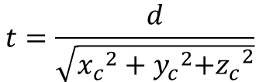
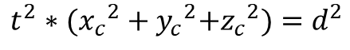
$$t^{2}∗({x_{c}}^{2}+{y_{c}}^{2}{{+z}_{c}}^{2})=d^{2}$$
2d -> 3d Transformation
$$t=\frac{d}{\sqrt{{x_{c}}^{2}+{y_{c}}^{2}{{+z}_{c}}^{2}}}$$

Slide 26
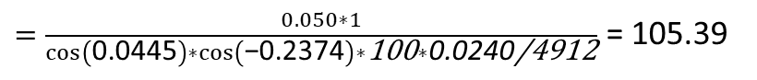
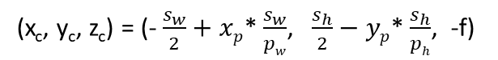
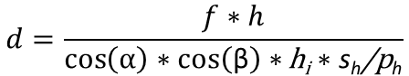
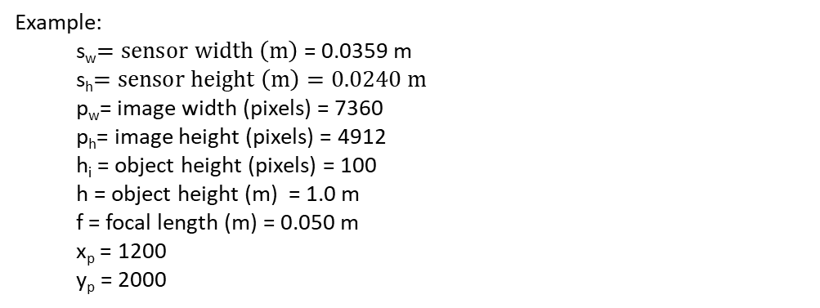
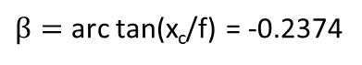
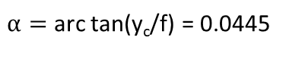
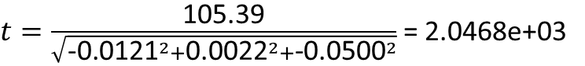
Example:
s_{w}$=sensor width \left(m\right)$ = 0.0359 m
s_{h}$=sensor height \left(m\right)=0.0240 m$
p_{w}= image width (pixels) = 7360
p_{h}= image height (pixels) = 4912
h_{i} = object height (pixels) = 100
h = object height (m) = 1.0 m
f = focal length (m) = 0.050 m
x_{p} = 1200
y_{p} = 2000
2d -> 3d Transformation
(x_{c}, y_{c}, z_{c}) = (- $\frac{s_{w}}{2}+xp$* $\frac{s_{w}}{pw}$, $\frac{s_{h}}{2}−yp$* $\frac{s_{h}}{ph}$, -f)
= (- $\frac{0.0359}{2}+1200$* $\frac{0.0359}{7360}$, $\frac{0.0240}{2}−yp$* $\frac{0.0240}{4912}$, -0.050)
= (-0.0121, 0.0022, -0.0500)
$α=$ arc tan(y_{c}/f) = 0.0445
$β=$ arc tan(x_{c}/f) = -0.2374
$$d=\frac{f∗h}{\cos\left(α\right)∗\cos\left(\text{β}\right)∗\text{h}\text{i}∗\text{s}\text{h}\text{/}\text{p}\text{h}}$$
$=\frac{0.050∗1}{\cos\left(\text{0.0445}\right)∗\cos\left(\text{−0.2374}\right)∗\text{100}∗\text{0.0240}\text{/4912}}$ = 105.39
$t=\frac{\text{105.39}}{\sqrt{{\text{−0.0121}}^{2}+{\text{0.0022}}^{2}+{\text{−0.0500}}^{2}}}$ = 2.0468e+03

Slide 27
Object location in 3d camera coordinates:
2d -> 3d Transformation
(x_{o}, y_{o}, z_{o}) = t* (x_{c}, y_{c}, z_{c})
= 2.0468e+03 * (-0.0121, 0.0022, -0.0500)
(-24.7593, 4.5602, -102.3389)
Open questions:
Derivation ok?
Assumptions ok?
Optical axis in sensor center?

Slide 28
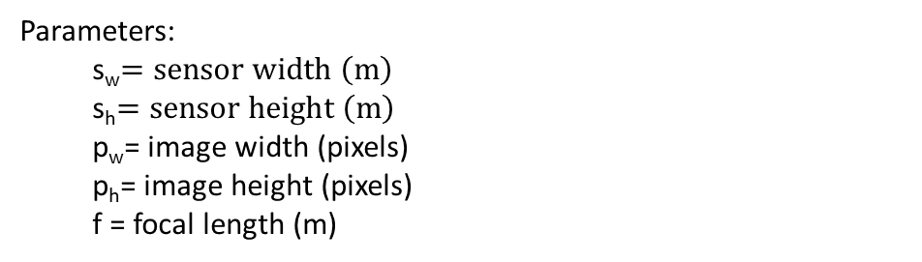
Parameters:
s_{w}$=sensor width \left(m\right)$
s_{h}$=sensor height \left(m\right)$
p_{w}= image width (pixels)
p_{h}= image height (pixels)
f = focal length (m)
2d -> 3d Transformation
Open questions:
Video metadata often lacks sensor and focal parameters
Focal length can change during shooting (zooming)

Slide 29
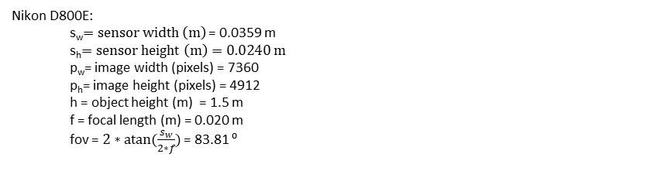
Experiment 1 in the wild (locations)
2d -> 3d Transformation
Different locations and heights
Nikon D800E:
s_{w}$=sensor width \left(m\right)$ = 0.0359 m
s_{h}$=sensor height \left(m\right)=0.0240 m$
p_{w}= image width (pixels) = 7360
p_{h}= image height (pixels) = 4912
h = object height (m) = 1.5 m
f = focal length (m) = 0.020 m
fov = $2∗atan⁡(\frac{s_{w}}{2∗f})$ = 83.81 ⁰

Slide 30
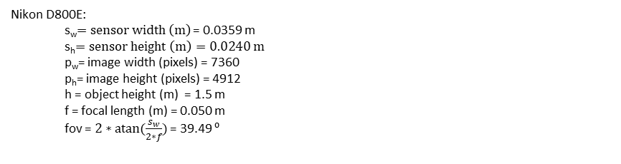
Experiment 2 in the wild (moving car)
2d -> 3d Transformation
Car speeds:
0
20 km/h
40 km/h
60 km/h
80 km/h
Distances:
10 m
20 m
30 m
40 m
50 m
60 m
70 m
80 m
90 m
100 m
Nikon D800E:
s_{w}$=sensor width \left(m\right)$ = 0.0359 m
s_{h}$=sensor height \left(m\right)=0.0240 m$
p_{w}= image width (pixels) = 7360
p_{h}= image height (pixels) = 4912
h = object height (m) = 1.5 m
f = focal length (m) = 0.050 m
fov = $2∗atan⁡(\frac{s_{w}}{2∗f})$ = 39.49 ⁰

Slide 31
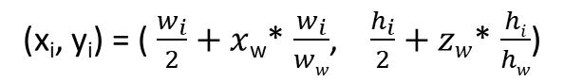
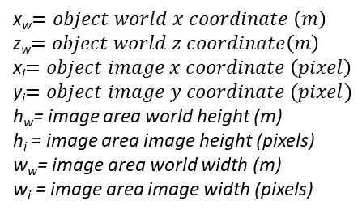
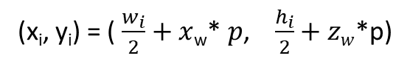
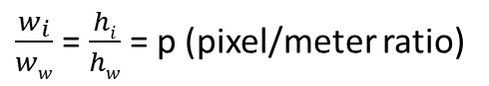
image x - coordinate
Map Presentation
object
field of view
image y – coordinate
observer
x
z
(x_{i}, y_{i}) = ( $\frac{w_{i}}{2}+x$_{w}* $\frac{w_{i}}{ww}$, $\frac{h_{i}}{2}+zw$* $\frac{hi}{hw}$)
x_{w}$=object world x coordinate \left(m\right)$
z_{w}$=object world z coordinate\left(m\right)$
x_{i}$=object image x coordinate \left(pixel\right)$
y_{i}$=object image y coordinate (pixel)$
h_{w}= image area world height (m)
h_{i} = image area image height (pixels)
w_{w}= image area world width (m)
w_{i} = image area image width (pixels)
$\frac{w_{i}}{ww}$ = $\frac{hi}{hw}$ = p (pixel/meter ratio)
(x_{i}, y_{i}) = ( $\frac{w_{i}}{2}+x$_{w}* $p$, $\frac{h_{i}}{2}+zw$*p)

Slide 32
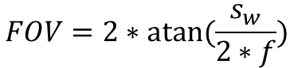
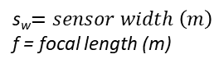
image x - coordinate
Map Presentation
object
field of view
image y – coordinate
observer
x
z
$$FOV=2∗atan⁡(\frac{s_{w}}{2∗f})$$
s_{w}$=sensor width \left(m\right)$
f = focal length (m)

Slide 33

Map Presentation

Slide 34
Before
Image World
Entity Diagram
Detected Object
Image Object
Event
Aero-
plane
Bus
Dining Table
Potted Plant
Bicycle
Car
Dog
Sheep
Bird
Cat
Horse
Sofa
Boat
Chair
Motor bike
Train
Bottle
Cow
Person
TV
Monitor

Slide 35
Entity Diagram
V2.0 goal
Detected classes not hardcoded
Object class may change
Support for many cameras , rotations
Names less awkward
Cleaning
Python style guide followed, excluding line length
Code optimization
One package
Name of the software package: ShadowWorld
(Plato: Allegory of the Cave)

Slide 36
V2.0
Entity Diagram
Presentation3D
PresentationMap
PresentationLog
…
Presentation
Speech
Synthesizer
World
Camera
”ImageObject”
”DetectedObject”
”WorldObject”
Event
Body
Pattern
Detection
Trace
Forecast
Bounding
Box

Slide 37
Body Kalman Filtering
Second order model does not work, constant acceleration makes bodies bounce back or get enormous velocities.
In world, constant acceleration for several (tens) of seconds is not common
First order model works! (No wonder it’s popular in robotics…)
When measurement is lost, the body is switched into constant velocity mode
In filtering terminology: velocity mode = only prediction, no correction
Algorithms described in [docs] folder documents

Slide 38

Body Kalman Filtering

Slide 39

Body Kalman Filtering

Slide 40


Body Kalman Filtering
Example: Car

Slide 41

Body Kalman Filtering
Measurement status: 1=measurement
0=no measurement

Slide 42

Body Kalman Filtering

Slide 43

Body Kalman Filtering

Slide 44

Body Kalman Filtering

Slide 45

Body Kalman Filtering

Slide 46


Example 2: Slow moving object
Body Kalman Filtering

Slide 47

Body Kalman Filtering
Takes long time to settle

Slide 48

Body Kalman Filtering

Slide 49

Body Kalman Filtering

Slide 50

Body Kalman Filtering
Filtering requires several seconds to achieve reliable results
Kalman filter parameters are not optimized
Optimization will be done later

Slide 51
Image-based situation awareness: Estimating location and velocity using single camera object detection
Paper
?????
Contents:
Abstract
Introduction
Related work
Our approach
Definitions
Object identity
Distance estimation
Location and velocity estimation
Movement prediction
Experiments
Test setup
Evaluation metric
Results
Other experiments
Conclusion
detection, pattern…
Hungarian algorithm, distance metrics,
movement prediction
geometry
Kalman filtering
Difference equation, uncertanties
In the wild. See previous slides. More?
Existing datasets? Which?

Slide 52
One solution for location estimation and movement prediction for video detected object (nearly) solved
Work needed:
Kalman filter parameter adjustment*
Experiments in the wild (see previous slides)
Other tests? (using existing (tracking) dataset)
Where to publish?
ECCV 2018 (8-14.9, Munich, deadline 14.3.2018, too soon)
CVPR 2019 (6/2019, Long Beach, deadline 11/2018)
ICCV 2019 (29.10.-3.11.2019, Seoul, deadline 1/2019)
Paper
*Locations and especially velocities take too much time to settle at the moment.

Slide 53



Representations for Interpretation
Representation: Video
Interpretation Generation
Object detection network
Representation: Pattern
…
Interpretation representations
I1
I2
I3
Location and velocity estimation
Language Generation
Representation: Body
Forecast
Representation: Time series

Slide 54

Example for interpretation representation: collision detection
Representations for Interpretation
Time series forecast for body locations
Interpretation Generation
(Symmetric) collision probability matrix
p_{nm} = probability that bodies n and m will collide

Slide 55




Some form of spatial simplification is needed, like
cube
rectangular prism
cylinder
sphere (probably the easiest math)
Probabilistic Model for Body
From state estimation
s
r_{c}
$$P\left(s\right)\sim N(s ⃓ μs, Vs)$$
$$P\left(rc\right)\sim N(rc ⃓ μr,c Vr,c)$$
y
Class specific, a priori
x
z

Slide 56




s_{i}
r_{i}
Collision Detection
d_{ij}
s_{j}
r_{j}
Collision C_{ij} if d_{ij} < r_{i} + r_{j}
Random variable
t: uniform distribution on [0, t_{end}]
Sampling:
Open question:
Too many dimensions?
More efficient sampling with MCMC / Metropolis-Hastings?

Slide 57

Simpler case: Collision with the observer
Collision Detection
y
S=[0,0,0,0,0,0]^{T} , deterministic, r = r[class person]
s
r_{c}
x
z
s
s_{i}
For each body i, a random vector r is sampled
and minimum distance to the observer calculated.
If the distance is less than r1+r, collision occurred. The proportion on collisions to
all cases is the probability estimate for the
body/observer collision.

Slide 58





Collision Detection
In our case:
x₁=P(0)
x₂=P(0)+V(0) (loc after one sec)
x₀=0
- ?
If t<=0, nearest point is P(0)

Slide 59


Example
Collision Detection

Slide 60




Example
Collision Detection

Slide 61



Example
Collision Detection

Slide 62


Example
Collision Detection
T=50.56 sec
P=0.000

Slide 63



Example
Collision Detection
T=51.00 sec
P=0.000

Slide 64



Example
Collision Detection
T=52.00 sec
P=0.003

Slide 65



Example
Collision Detection
T=54.00 sec
P=0.019

Slide 66



Example
Collision Detection
T=56.00 sec
P=0.027

Slide 67



Example
Collision Detection
T=58.00 sec
P=0.019

Slide 68
Collision Detection
Open questions:
How to make uncertainty smaller?
Collision matrix reachable?

Slide 69





Side effect: instead of using height in distance estimation,
radius of enclosing circle will be used:
Collision Detection
w
From bounding box coordinates to radius:
α
r
h
$$r=\sqrt{{(\frac{w}{2})}^{2}+{(\frac{h}{2})}^{2}}$$
$$h=(ymax−ymin)$$
$cy=(ymax+ymin)$/2
$$w=(xmax−xmin)$$
$$cx=(xmax+xmin)/2$$

Slide 70




Distance estimation using object radius:
Collision Detection
$$d=\frac{f∗h}{\cos\left(α\right)∗\cos\left(\text{β}\right)∗\text{h}\text{i}∗\text{s}\text{h}\text{/}\text{p}\text{h}}$$
s_{w}$=sensor width \left(m\right)$
s_{h}$=sensor height \left(m\right)$
p_{w}= image width (pixels)
p_{h}= image height (pixels)
h_{i} = object height (pixels)
h = object height (m)
f = focal length (m)
$α$ = altitude (rad)
β = azimuth (rad)
Before
$$d=\frac{f∗r}{\cos\left(α\right)∗\cos\left(\text{β}\right)∗r\text{i}∗\text{s}\text{h}\text{/}\text{p}\text{h}}$$
s_{w}$=sensor width \left(m\right)$
s_{h}$=sensor height \left(m\right)$
p_{w}= image width (pixels)
p_{h}= image height (pixels)
r_{i} = object radius (pixels)
r = object radius (m)
f = focal length (m)
$α$ = altitude (rad)
β = azimuth (rad)
Now

Slide 71


Distance estimation using object radius:
Collision Detection
$$t=\frac{d}{\sqrt{{x_{c}}^{2}+{y_{c}}^{2}{{+z}_{c}}^{2}}}$$
(x_{c}, y_{c}, z_{c}) = (- $\frac{s_{w}}{2}+xp$* $\frac{s_{w}}{pw}$, $\frac{s_{h}}{2}−yp$* $\frac{s_{h}}{ph}$, -f)
(x_{o}, y_{o}, z_{o}) = t* (x_{c}, y_{c}, z_{c})

Slide 72

Body radius distribution
Distibution should:
be defined in [0,∞]
mode > 0
simple
skew controllable
Collision Detection

Slide 73


Log-normal distribution for body radius:
Collision Detection
Used in the context of describing human height distribution

Slide 74


Example: Person
Collision Detection

Slide 75

Bubble diameters (2*radius)
Collision Detection

Slide 76

Bubble diameters (2*radius)
Collision Detection

Slide 77

Bubble diameters (2*radius)
Collision Detection

Slide 78

Bubble diameters (2*radius)
Collision Detection

Slide 79

Bubble diameters (2*radius)
Collision Detection

Slide 80

Bubble diameters (2*radius)
Collision Detection

Slide 81

Bubble diameters (2*radius)
Collision Detection

Slide 82

Bubble diameters (2*radius)
Collision Detection

Slide 83

Bubble diameters (2*radius)
Collision Detection

Slide 84

Bubble diameters (2*radius)
Collision Detection

Slide 85



Path chosen - a simpler solution which provides a lot more information
Prediction
Update is done n times
A
μ
∆ has to be smaller than 1/fps. If fps=25, 1/fps = 0.04 sec. A car driving 120 km/h will proceed
1.33 meters and a collision with an observer might not be detected well enough. A value of ∆ = 0.01 corresponds to the movement of 33 cm for an object moving at 120 km/h. This will generate 100 predictions per second. If we want the prediction horizon to be 10 secs, we have
1000 predictions per object. Predicting for every frame will generate fps*1000 ≈ 25 000 predictions per second per object. This is too much, so only current prediction is saved.

Slide 86

Prediction

Slide 87



Collision with the observer
Collision Detection
d₁
P(t’) = nearest point on the predicted trajectory
d
O
d_{o}
$$x\left(t\right)=x\left(0\right)+v_{x}\left(0\right)∗t$$
$$y\left(t\right)=y\left(0\right)+v_{y}\left(0\right)∗t$$
$$z\left(t\right)=z\left(0\right)+v_{z}\left(0\right)∗t$$
$$d^{2}\left(t\right)={x(t)}^{2}+{y(t)}^{2}+{z(t)}^{2}$$
$$d^{2}={(x\left(0\right)+v_{x}\left(0\right)∗t )}^{2}+{(y\left(0\right)+v_{y}\left(0\right)∗t )}^{2}+{(z\left(0\right)+v_{z}\left(0\right)∗t)}^{2}$$
$\frac{d({d(t)}^{2})}{dt}=2∗\left(x\left(0\right)+v_{x}\left(0\right)∗t \right)∗v_{x}\left(0\right)+$ $2∗\left(y\left(0\right)+v_{y}\left(0\right)∗t \right)∗v_{y}\left(0\right)+$ $2∗\left(z\left(0\right)+v_{z}\left(0\right)∗t \right)∗v_{z}\left(0\right)=0$
$t^{′}=$ $−\frac{x\left(0\right)∗v_{x}\left(0\right)+y\left(0\right)∗v_{y}\left(0\right)+z\left(0\right)∗v_{z}\left(0\right)}{{v_{x}\left(0\right)}^{2}+{v_{y}\left(0\right)}^{2}+{v_{z}\left(0\right)}^{2}}$

Slide 88
Work in Progress

Slide 89
Perception
“The first step in achieving SA is to perceive the status, attributes, and dynamics of relevant elements in the environment. Thus, Level 1 SA, the most basic level of SA, involves the processes of monitoring, cue detection, and simple recognition, which lead to an awareness of multiple situational elements (objects, events, people, systems, environmental factors) and their current states (locations, conditions, modes, actions).”

Slide 90
Next Steps

Slide 91
Next steps
Comprehension:
Closing the open questions
2d -> 3d transformation
World object state estimation

Slide 92
To Be Discussed

Slide 93
To Be Discussed
Activity recognition?
Emotion recognition?
Turning camera, estimation by background movement?

Slide 94
Thank you!
lampola@student.tut.fi
https://github.com/SakariLampola/Thesis

